Slide 1

Logistic Regression in R Shiny
Is Adam Sandler covered in eels?
Presented by:
Sarah Kilday
Tereza Martinovska
Katarina Moravkova
Carolyn Saund

Slide 2
First of all… what is R Shiny?

Slide 3
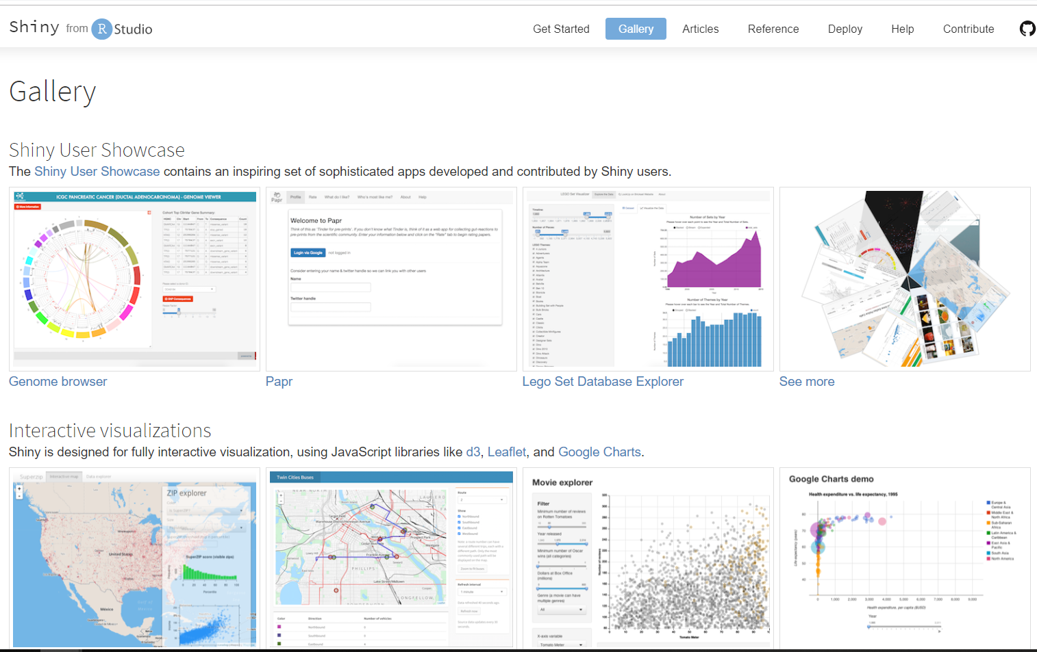
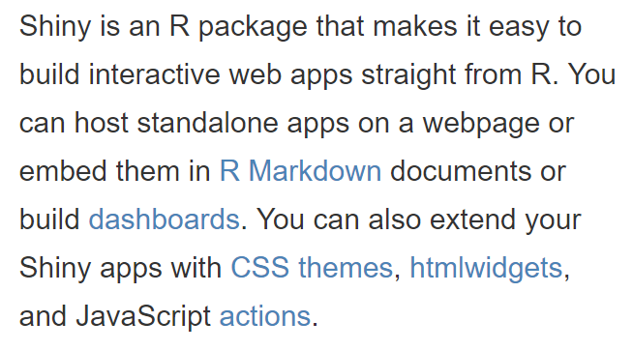
First of all… what is R Shiny?

Slide 4

First of all… what is R Shiny?

Slide 5
R Shiny is often used for interactive data visualisation

Slide 6
But so far…

Slide 7

But so far…
R Shiny has not witnessed…

Slide 8
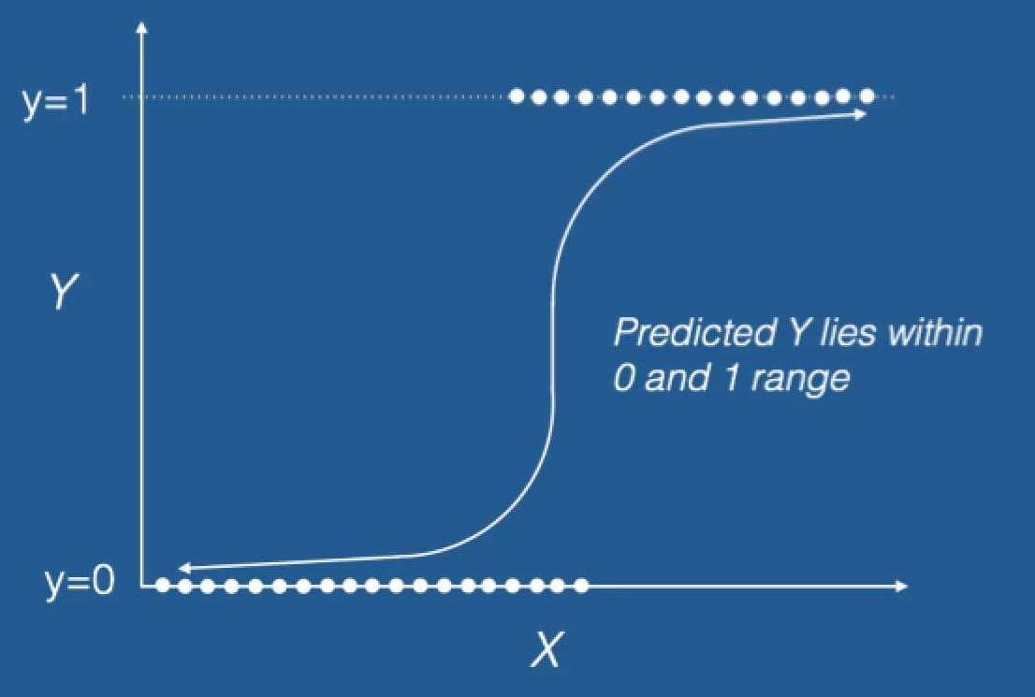
¡¡¡Logistic regression!!!!

Slide 9

¡¡¡Logistic regression!!!!

Slide 10
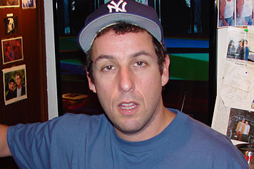

What is Logistic regression?
Logistic regression is a statistical approach which describes the relationship between a certain variable and its predictors.
It is a tool which can be used for classifying CATEGORICAL outcomes e.g. YES/NO, WIN/LOSE, EELS/NO EELS
¿¿¿ ???

Slide 11

Our INTENDED approach
Use Oscars data set to show relationships between various predictors for determining whether a film wins or doesn’t win an Oscar, e.g. budget or score
Find nice visualisations so users can play around with the sliders and such
Create tutorials to check knowledge of logistic regression after interacting with the app
Show Adam Sandler will never be in a film which wins an Oscar and get our app published in a prestigious scientific journal, e.g. Nature or Science

Slide 12
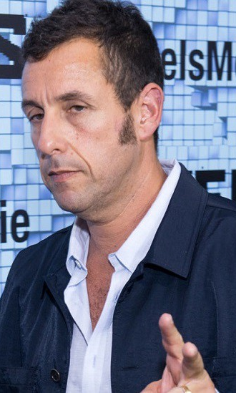
The ACTUAL approach
Generate random dataset because the Oscar dataset doesn’t work the way we imagined and is a bit messy for the R Shiny purposes
Find nice visualisations so users can play around with the sliders and such
Create tutorials to check knowledge of logistic regression after interacting with the app
Insert Adam Sandler jokes for no real purpose at all

Slide 13
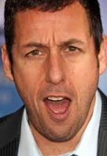
*The App*
Let’s have a look!!!
https://ug-formal-models-2019.shinyapps.io/tutorial/?fbclid=IwAR38o4eZh1xRIaItHYlAt7oKM4pdMZ5ohScKVFJxJSQAzKNbMxVK4JUq4vg

Slide 14

¡¡¡Thanks everyone (Martin) for listening!!!!

